Slide 1
Physical water supply
Irrigation unit
Arduino Control Software
Google Firebase cloud database
Hardware + PCB
3D printed case
Android app

Slide 2
On every duty cycle:
Status
telemetry
Arduino Control Software
Google Firebase cloud database
On every power cycle:
Parameter settings
On user request:
Parameter updates
On user request:
telemetry
Android app

Slide 3
System description
valve
Water hose
Valve driver
Add-on
Arduino
WeMOS D1
(w/wifi)
Battery and charge unit
Solar panel
Power
On/off
Mode
(moisture/ water)
probe

Slide 4
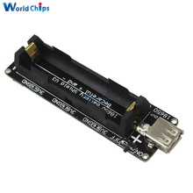
Battery and charge unit (no solar panel)
https://www.aliexpress.com/item/Battery-Shield-For-WeMos-D1-mini-single-lithium-battery-charging-boost/32679485736.html?spm=a2g0s.9042311.0.0.27424c4dXElp5z
Charging Voltage: max: 10V, recommend: 5V
Charging Current: max: 1A
Lithium Battery voltage: 3.3-4.2V
Boost Power Supply: 5V(max: 1A)
New Solar Panel Module for Light Battery Cell Phone Charger Portable 12V 3W DIY
18650 battery shield

Slide 5
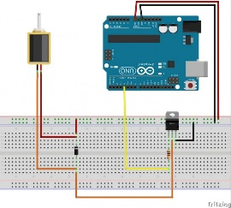
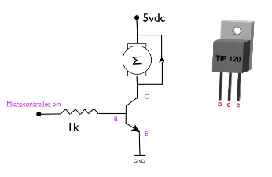
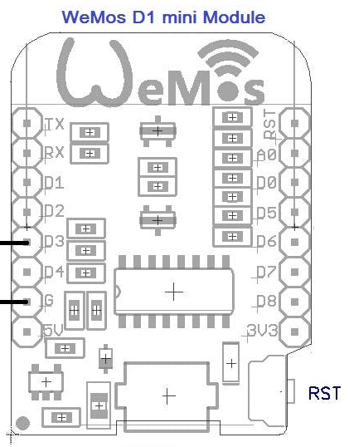
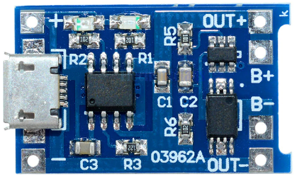
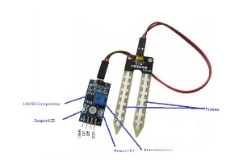
Schematics
5V
Battery shield and charge controller
TP4056
Solar panel
Lion
battery
TIP120
Front
B C E
5V valve
5k
FC-28

Slide 6
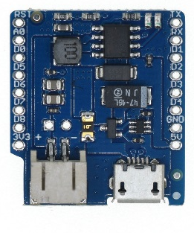
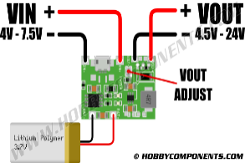
Power unit & solar panel
https://www.aliexpress.com/item/5PCS-Micro-USB-5V-1A-18650-Lithium-Battery-Charger-Board-With-Protection-Module/32216806621.html?spm=a2g0s.9042311.0.0.27424c4dPbR7qN
Current- 1A adjustable.
Charge precision- 1.5%.
Input voltage- 4.5V-5.5V, max 8V
Full charge voltage- 4.2V.
Led indicator- red is charging Green is full charged.
Inversed polarity- NO.
New Solar Panel Module for Light Battery Cell Phone Charger Portable 12V 3W DIY
Lion
battery
5V
Battery shield and charge controller
TP4056
Solar panel
J5019 Li_Ion charge controller

Slide 7
Software components
Sensors
initialization
monitoring
Actuators
Configuration & link to sensors
Initialization
Cloud comm
connection
reporting
Main Control
Power & Sleep
Wifi mgt
Initialization
connectivity
Sleep
Persistent storage
configuration
Controlling
Configuration
Via app
Hard coded
Operating modes
Globals
Global types and structures
Global names and constants
Grab from:
Barcode
carmonitor
carmonitor
?
carmonitor
App: carmonitor
Barcode

Slide 8
Physical layout

Slide 9
OLD STUFF

Slide 10
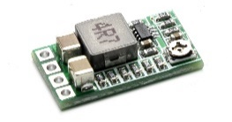
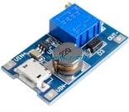
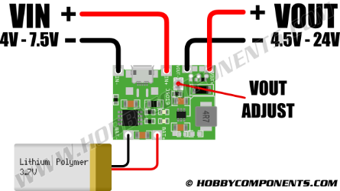
Schematics
Add-on
18650 battery shield
Step down converter
Solar panel
5V
5V
5V
5V
step-up converter
TIP120
Front
B C E
12V
1k
1N4001
5V
J5019 Li_Ion charge controller

Slide 11

System overview
220V supply
12V supply
5V supply
Ctrl / sensor
groundr
Water out
Water in
Valve array
V1
V2-8
BBB power
5V
BBB
ethernet
D1
4 pole pin
P9.11 = GPIO0_30
1 x 1,8V ctrl
4 pole pin
P8.7, p8.8
1 x RJ-45 (8 hot)
1 x gnd cable
12V in
Valve drivers
3 x 1,8V ctrl
P8.9
P xx
4 pole pin
Water
sensors
4 x USB
4 x 1,8V sensor
4 x USB
4 x water measure
5V supply
P9.5, p9.6
(red)
5V relay
(red)

